Slide 1
How to Apply for Graduation
Presented by:
Office of the University Registrar,
Degree Evaluations

Slide 2
Eligibility to Apply for Graduation
Must be declared in a major (no pre-major, expressed interest or undeclared)
Must have a major and minor (if applicable) advisor assigned
Must have earned 85 units

Slide 3
Step One
Log in to the Student Center
Click the arrow to the right of ‘Academics’
Choose ‘Apply for Graduation (New)’

Slide 4
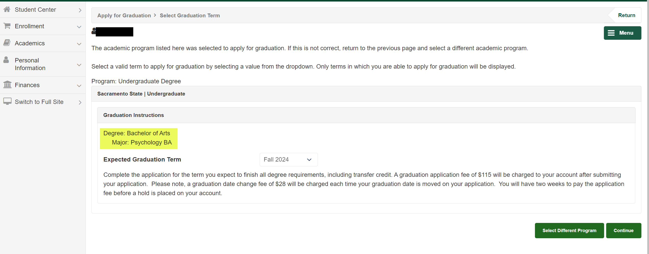
Step Two
Confirm that the major and minor (if applicable) are correct
If not, please have your advisor complete a ‘major/minor change form’ on your behalf or, complete a ‘deletion of major/minor’ form in your OnBase Forms before proceeding
*If you have not met the eligibility to apply for graduation, the link will not be available*

Slide 5
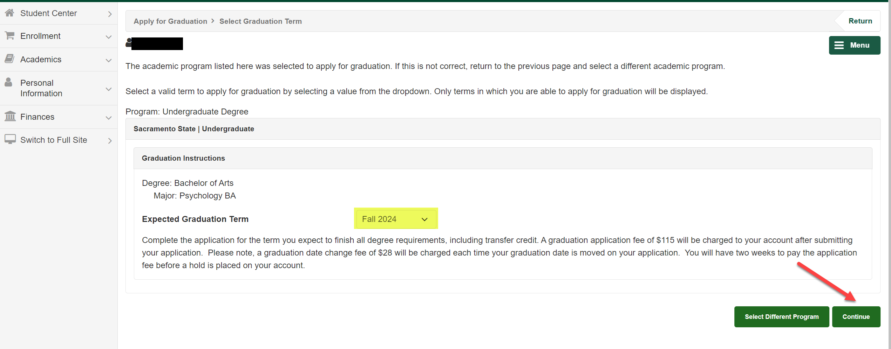
Step Three
Select the appropriate ‘Expected Graduation Term’ from the drop down menu based on the term that all of your degree requirements will be completed *NOT THE COMMENCEMENT TERM YOU WANT TO PARTICIPATE IN!*
Click ‘Continue’

Slide 6
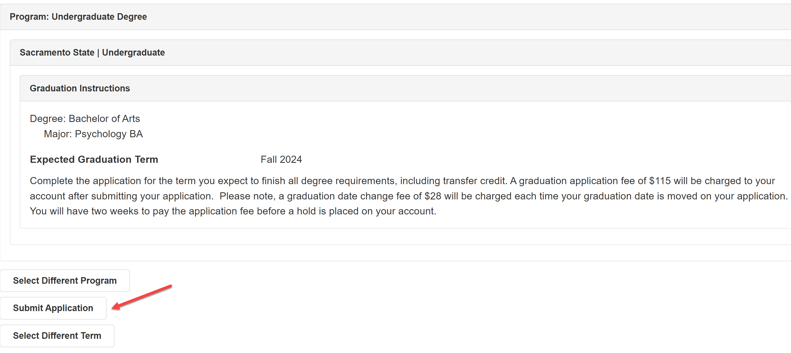
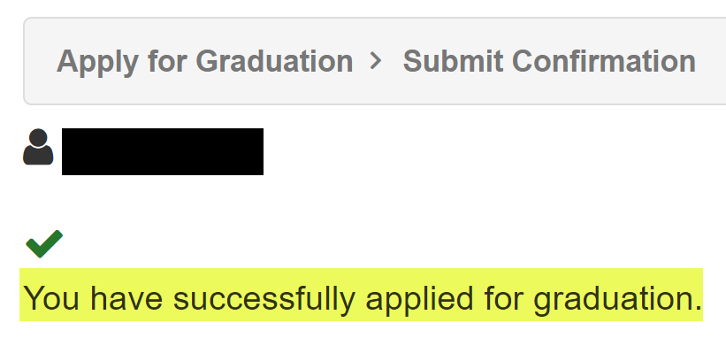
Step Four
Click ‘Submit Application’ and see the confirmation message

Slide 7
What happens to the Graduation Application after submission?
Degree Advisors review the student account for graduation eligibility and provide feedback to the student.
Graduation Application is marked as ‘Evaluated by Registrar’.
Once the Degree Advisor has changed the application status to ‘Evaluated by Registrar’, the student will receive feedback via their CSUS email.
Students that have applied for graduation before the soft deadline are prioritized for review.
The graduation application is routed to the Degree Advisor liaison in the Office of the University Registrar.
The student’s major/minor department is able to leave feedback on the student application at any time.

Slide 8
Graduation Application Fee
$115 Graduation Application Fee
=
$35 Diploma Fee +
$80 Commencement Fee
*This fee is charged shortly after applying for graduation. Once it has posted, you have two weeks to pay the fee before a hold is placed on your account.*

Slide 9
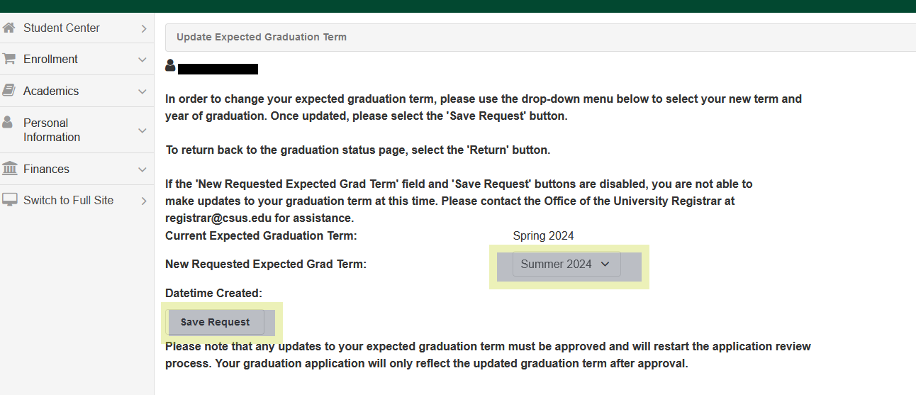
Changing your Graduation Term
If changes need to be made to your term of graduation, go back into the graduation application through the Student Center
Click ‘Update Expected Grad Term’ and select the new graduation term
Click ‘Save Request’
The application will go back to the first step in the review process
Your account will be charged $28 for a graduation date change fee

Slide 10
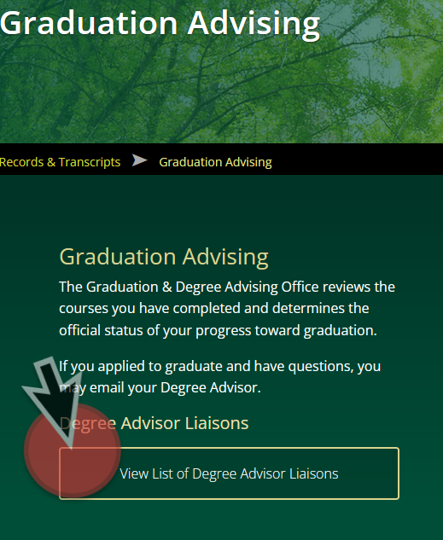
Questions?
Refer to your Degree Advisor liaison for your major found at:
https://www.csus.edu/student-life/records-transcripts/graduation-advising/
Or, contact: Registrar@csus.edu

