Slide 1
Meaning
An observation or a general statement about a subject such as film

Slide 2
Expectations and Films
Viewers, before seeing a film, have certain expectations about it. Possibly from the trailer, the title, the stars involved or even the director. Some of the expectations will come true and some will not.
When viewing a film an audience may readjust their hypothesis about what might happen or why something happened. They may consequently experience puzzlement or clarity or they may feel excitement, pleasure, disappointment, boredom, frustration or some other response

Slide 3
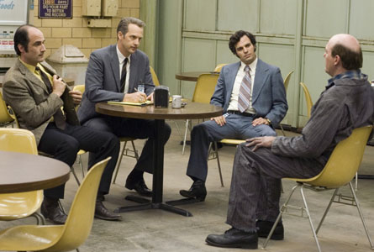
Responses to the film Zodiac
“There are no tidy, last-minute plot twists to make you feel good in Fincher's Zodiac, just focus -- to keep an audience focused -- and the most disciplined filmmaking you've seen in forever.” --Bob Mondello NPR
The problem with making a film about an unsolved crime is that the ending of the film is ambiguous. But the actors were good. There were interesting color schemes used, lots of blue and grey undertones - which made it visually appealing for me. --Taryn M (a student)

Slide 4
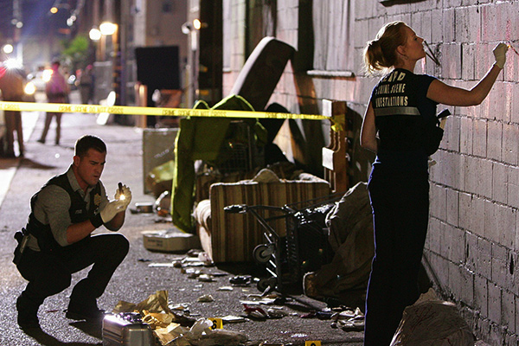
Expectations
Why is it so frustrating to see a film about a crime that doesn’t get solved?
It could be that you have developed, over time, that expectation of procedurals.
For instance, on a show like CSI, you see a murder and that murder is usually solved by the end of the hour show.
Having that expectation met is comforting, because it feels familiar
There is also another implicit meaning: Crimes happen, they get solved, and therefore we can all feel safe and sound in front of our TV’s.

Slide 5
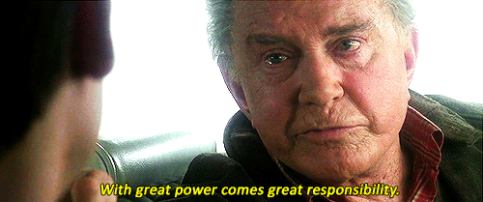
Explicit Meaning
General observations included in a text about one or more of its subjects.
Explicit meanings are common in silent films in the form of title cards. The lack of dialogue and sound increased the need for explanation.
They are also commonplace in informative documentaries where a narrator will communicate some information or editorialize about a situation
Statements like the one shown here(from Spiderman) are pretty rare in contemporary filmmaking
Big themes like this are usually represented as implicit meanings in contemporary film. In other words they do not need to be stated outright, the story communicates them.

Slide 6

Implicit Meanings
a generalization that a viewer makes about a film (text) or about a subject in a film (text) The film Social Network demonstrates the above explicit meaning through the story (implicit meaning)

Slide 7
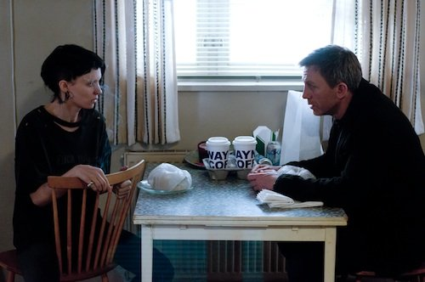
Technique and Implied Meanings
Composition
Lighting
Camera Distances
Sound Mixes
Editing: For Instance—Hollywood montage implies the compression of time
What implicit meanings can be taken from this shot?
If the lighting, surroundings, costumes and placement of the characters were different, how would the meaning change?

Slide 8

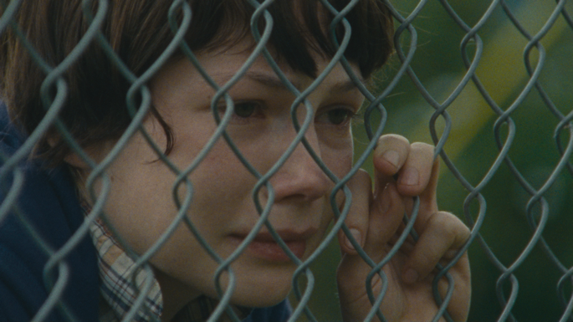

The progression of imagery from Wendy having companionship to her isolation imply (visually) that she is embarking on the rest of her journey alone

Slide 9
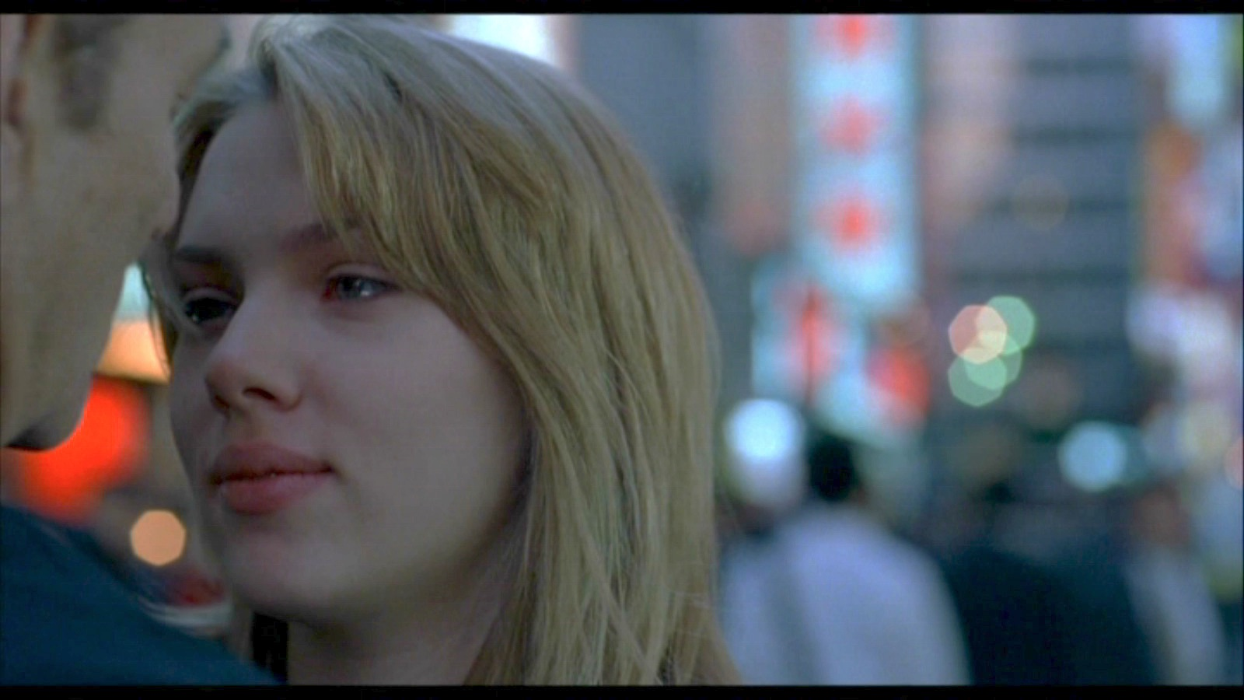
Ambiguity
Open to one or more plausible interpretation of their meanings:
Lost in Translation (Link)

Slide 10

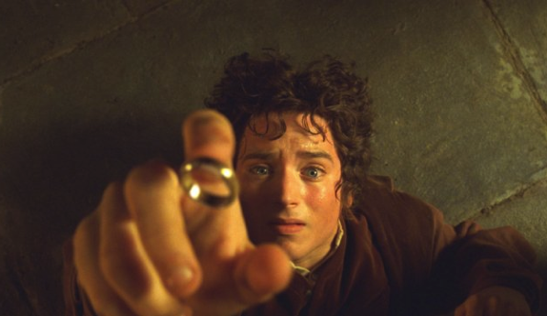
Realism vs Fantasy
Most films occur somewhere between these two extremes
If a film is more realistic in story approach—audiences expect plausibility to be a factor
Only films that are attempting to be more realistic will make you ask “Could that really happen?”
You wouldn’t ask that watching Lord of the Rings. Because it’s fantasy, you assume implausible things can happen

Slide 11
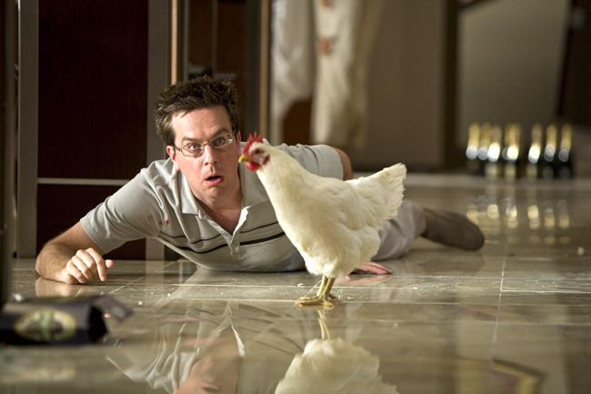
This scene may raise some eyebrows for skeptics
When reality is pushed to extremes like in The Hangover
the result is considered absurdist
The famous hotel scene lies somewhere in-between the fantasy-reality continuum.

Slide 12
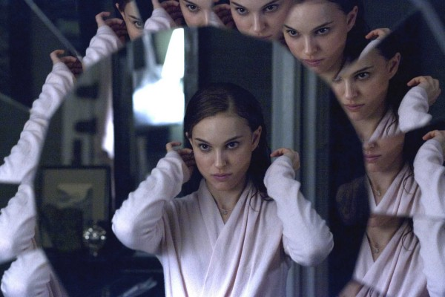
Symbol
Anything perceptible that has meaning or significance beyond its usual meaning or significance. In this shot from Black Swan, the character is looking in the mirror (usual meaning) The way that her image is repeated is alluding to her identity being in question—or its fragmentation.

Slide 13
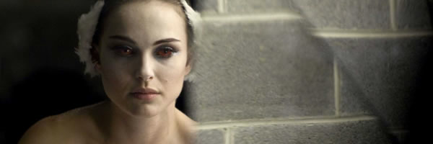
Symbol
This shows a fracture of her identity and her perception of self (instead of just a broken mirror)

Slide 14
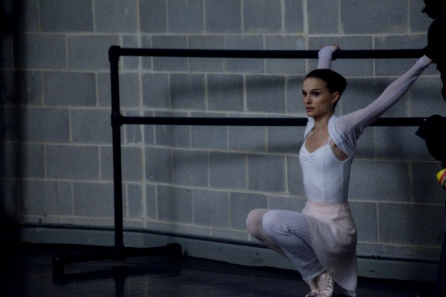
Symbol
This is more subtle, but the shadows are fragmenting her
Her position shows a desire to break free—and could also be alluding to the swan

Slide 15
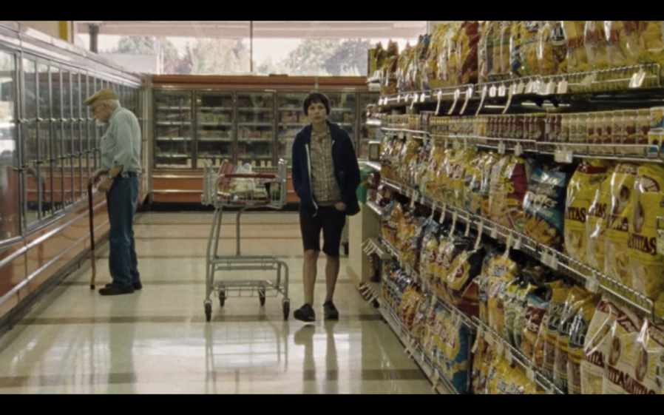
Critical Approach
Ideology: the fundamental beliefs and values of a society or social group
Liberals and conservatives might have opposite viewpoints about the shoplifting scene in Wendy and Lucy

Slide 16
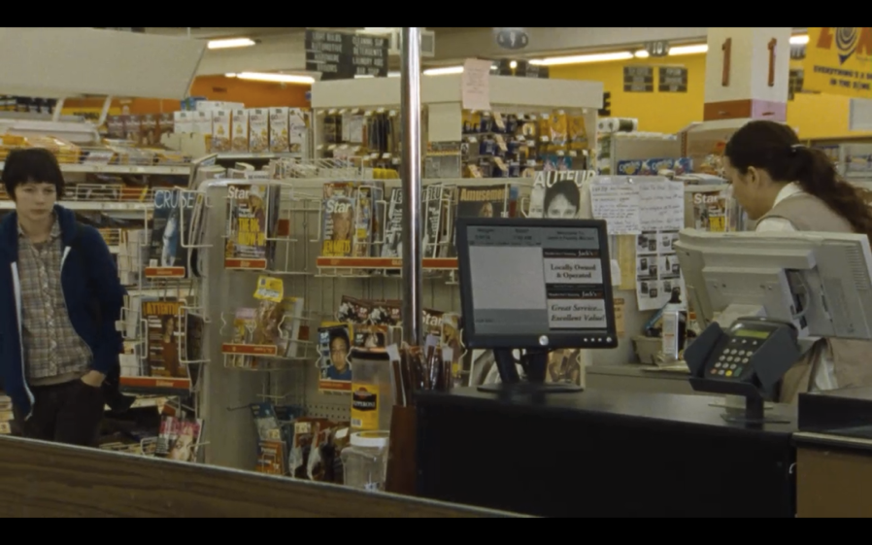
Experience and Values
Life experience may also influence a viewer’s reading of the shoplifting scene

Slide 17
Influences on Viewer Interpretations of film meanings
Viewer’s knowledge of the film’s subject
Viewer’s knowledge of the film
Backgrounds
Political viewpoints
Sexual orientation
Meanings also reflect the time and place where a viewer lives and perhaps the interpretive community to which the viewer belongs

Slide 18
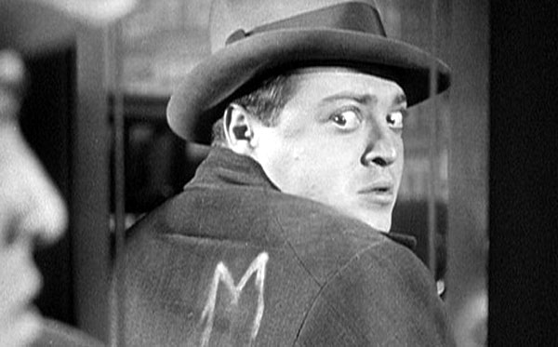
Many approaches can be taken to critically read a film
Historical approach: What is the historical context of the film?
Class analysis: What role does social class play in the film?
Identity politics: The representation of race, gender or sexual orientation are taken into account when reading the film.
Auteur theory: Reading a film in the context of the director’s other films
Genre theory: Reading a film in the context of other films of that genre
Formal approach: Reading a film in terms of formal choices: lighting, framing, editing, sound design etc.

