Slide 1
Butch Cassidy and the Sundance Kid
George Roy Hill, 1969

Slide 2
Cinematographer
Conrad Hall (who also shot American Beauty and Road to Perdition)
Utilizes flat space in most of his films
Movement in the first scene takes place on the axis of the tripod: pans, tilts, zooms
Most of the movement in Rules of the Game—physically moves through space: dolly, crane, track
Create a look of deep space

Slide 3
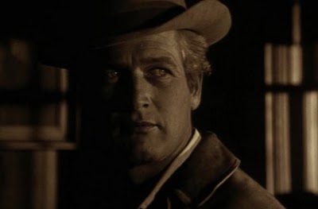
Opening Scene:
Flat space
Montage style of editing
Tight shots making up the scene rather than deep space (like Rules of the Game)
The series of tight shots also give a sense of claustrophobia
Also makes a reference to jail—something Butch is afraid of as an outlaw

Slide 4
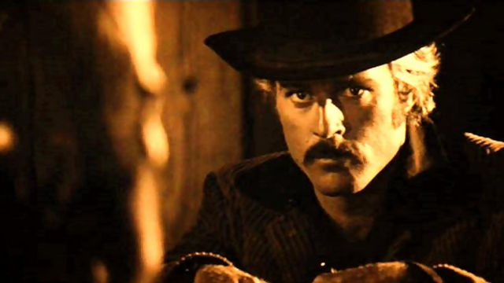
Second scene
Moves from tight framing to loose framing
Extremely long take at the beginning of the scene
Increases tension and introduces conflict

