Slide 1
Film and Meaning
Explicit
Implicit
Generalizations included in a text about one or more of its subjects
Explicit meanings are sometimes thought as flawed in Western storytelling, because these audiences like meanings to be suggested and not explained
An explicit meaning is not necessarily comprehensive or persuasive, and it is not the definitive word on any of the film’s projects
An implicit meaning is a generalization that a person makes about a text or a subject of a text
A film’s mise en scene, cinematography, editing and sound can suggest or reinforce meanings
Narrative itself is a major source of implicit meanings, because viewers often infer some general implications of a story
A narrative or some aspect of it may be unknowable or ambiguous: it is open to two or more plausible interpretations perhaps because it provides conflicting information and withholds significant information
Filmmakers and other makers of texts may create symbols: anything perceptible that has significance beyond its usual meaning or function. Usually symbols go unexplained in films and viewers interpret them variously

Slide 2
Is a similarity a formula?
It’s not déjà vu. Summer movies are often described as formulaic. But what few people know is that there is actually a formula—Save the Cat! The Last Book on Screenwriting You’ll Ever Need. In the book, author Blake Snyder, a successful spec screenwriter who became an influential screenplay guru, preaches a variant on the basic three-act structure that has dominated blockbuster filmmaking since the late 1970s.
(Opening image)
(Theme is stated) (Set-up)
(Catalyst)
(Debate)
(Break into Act II)
(Fun and games)
(Midpoint)
(Bad guys close in)
all-is-lost moment
dark night of the soul.
(Break into Act III)
(Finale)
(Final image)

Slide 3
Documentary Film
Film or video representation of actual (not imaginary) subjects

Slide 4
Documentary Filmmakers
Select what subjects to film and in what ways
They can combine footage they shoot with already existing footage
Sometimes they stage or re-create situations
Edit the resultant footage

Slide 5
Mediated reality
In every documentary, every edit you make, every choice you make is yours (the filmmaker’s judgment call)
Even when filmmakers like the Maysles brothers try to be a “fly on the wall” they still choose what to look at and what eventually makes it into the film (link)
Mediate means to work as an intermediary between two sides—or work as a go-between
Reality—documentary film—viewer
The documentary is not reality, but an intermediary between reality and the viewer
It may seem to represent reality objectively, but it does not
A documentary film is never an objective indisputable truth
It is the result of the selections, recordings and manipulations of one group of filmmakers

Slide 6
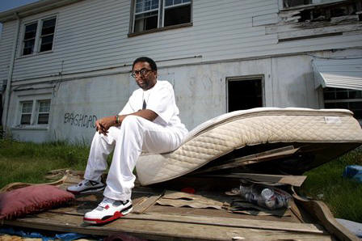
What do documentaries do?
Inform All documentaries do this
Entertain Most documentaries are meant to entertain, because that is how they hold the viewer’s interest
Criticize made out of the filmmakers conviction that something is wrong
Celebrate present a topic in a way that viewers can appreciate or admire
Achieve more than one goal
Link: When the Levees Broke, A Requiem in 3 Acts accomplishes all of these goals

Slide 7
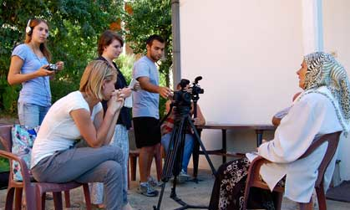
Informative Language
narration, title cards or subtitles, interviews, signs (or a combination)
Before 1960 most films Featured a strong voiced, supposedly impartial male narrator
This changed due to availability of portable equipment as well as the belief that no single narrator can do justice to a subject’s complexity

Slide 8
Artifacts
May film new material (staged or not)
May represent subjects in a realistic or stylized way
May use existing footage
Photographs
Fragments of radio broadcasts
Audio recordings
Still photographs
Signs and maps
Editing all of these sources is like creating a film from scratch
Artifacts and informative language help persuade the viewers of the accuracy of a film’s representation

Slide 9
Non-narrative documentary
Scientific films
Many TV documentaries
Industrial films
Training films
Promotional films
Sometimes they make an argument for or against something
Present various types of information organized into categories

Slide 10
Narrative Documentary
Like fictional films, narrative documentaries represent events chronologically or non-chronologically
There is a fabula (logical sequential order of events) and the the plot can follow the fabula closely or out of order
Many have a single plotline, but like fictional films they may have two or more

Slide 11
Narrative Documentaries can use the following expressive narrative techniques
3 act structure
Split screen
Parallel editing
Cutaway editing (action reaction)
Slow motion
Fast cutting
Slow cutting
Transitions

Slide 12
Roger and Me, Parallel Editing
Link here
How does the use of parallel editing communicate a meaning in this scene?
How does the use of a sound bridge communicate a meaning in this scene?
Do you think that the use of narrative technique diminishes the informative role of documentary?

Slide 13
Documentary Filmmakers
Select what subjects to film and in what ways
They can combine footage they shoot with already existing footage
Sometimes they stage or re-create situations
Edit the resultant footage

Slide 14
Mediated reality
In every documentary, every edit you make, every choice you make is yours (the filmmaker’s judgment call)
Mediate means to work as an intermediary between two sides—or work as a go-between
Reality—documentary film—viewer
The documentary is not reality, but an intermediary between reality and the viewer
It may seem to represent reality objectively, but it does not
A documentary film is never an objective indisputable truth
It is the result of the selections, recordings and manipulations of one group of filmmakers

Slide 15
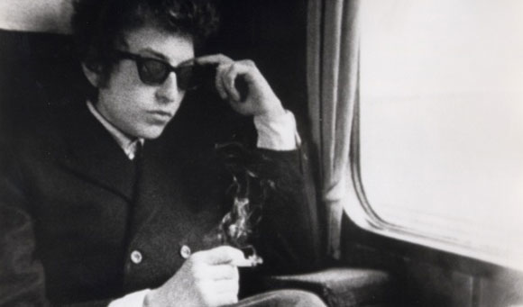
Technology and Documentary
Before the 1960’s equipment was heavy and not very portable
Late 50’s and early 60’s introduction of 16mm film cameras and fast film
Portable sound packs
Direct Cinema came from these advances as well as Cinéma vérité in France
Imperfections can strengthen the film’s credibility
Don’t Look Back (1967)

Slide 16
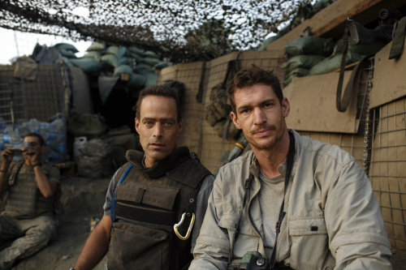
Video Technology
Longer takes
Fewer interruptions while filming
Greater portability—access to subjects
Less intrusive
Relatively inexpensive—opening up possibilities for more and more people to make them
Restrepo 2010

Slide 17
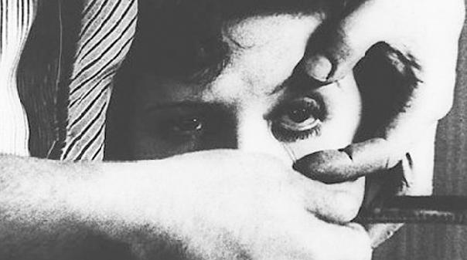
Experimental Films
Definition
Difficult to define, because there are so many films with that title
Avant-garde, underground, personal and independent
Reject the conventions of the most popular mainstream films
Rebel against what movies are and what they stand for

Slide 18
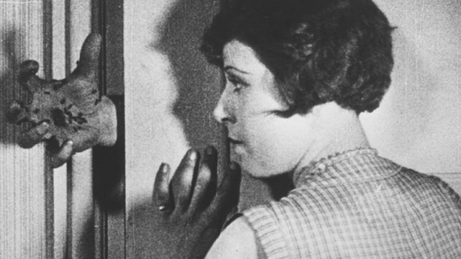
Surrealism
Un Chien Andalou 1928 by Luis Bunuel
1920’s and 30’s a movement in European art, drama, literature and film in which an attempt was made to portray the workings of the subconscious mind as manifested in drams

Slide 19
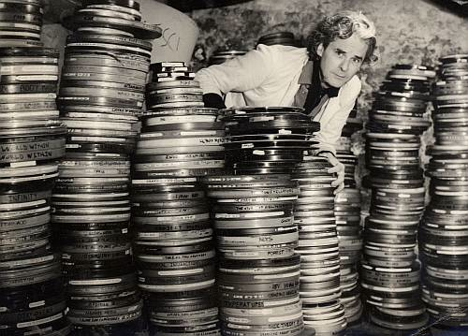
Sources and Technique
Fictional Films or Film Theory
Optical Printer
Negative (found footage)
Personal Subjects
Recorded footage
Unexpected editing techniques
Film or Television History
Art History
Political or Social beliefs

Slide 20
Representational or Abstract
Representational
Abstract
The subjects are recognizable as people and real objects (Like Un Chien Andalou)
The subjects are unrecognizable (or)

Slide 21
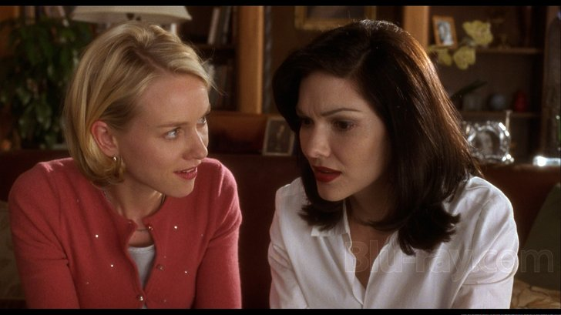
Hybrid Films
Mulholland Drive 2001
Experimental and Documentary
Installation Video and Photography
Experimental Narrative
Experimental Independent Films

