Slide 1
Job-Order Costing: Cost Flows and External Reporting
Chapter 3
Managerial Accounting
Seventeenth edition
© 2021 McGraw Hill. All rights reserved. Authorized only for instructor use in the classroom. No reproduction or further distribution permitted without the prior written consent of McGraw Hill.

Slide 2
Important Vocabulary Terms 1
There are seven important vocabulary terms that were introduced in the previous chapter.
Job-order costing – A costing system used in situations where many different products, jobs, or services are produced each period.
Absorption costing – A costing method that includes all manufacturing costs—direct materials, direct labor, and both variable and fixed manufacturing overhead—in the cost of a product.

Slide 3
Important Vocabulary Terms 2
The equation shows how to calculate the predetermined overhead rate.
Allocation base – A measure of activity such as direct labor-hours or machine-hours that is used to assign costs to cost objects.
Predetermined overhead rate – A rate used to charge manufacturing overhead cost to jobs that is established in advance for each period. It is computed using the following equation:
Predetermined overhead rate = Estimated total manufacturing overhead cost ÷ Estimated total
amount of the allocation base

Slide 4
Important Vocabulary Terms 3
The equation for applying the overhead is also shown.
Overhead application – The process of assigning overhead costs to specific jobs using the following formula:
Overhead applied to a particular job = Predetermined overhead rate × Amount of allocation base incurred by the job
Normal costing – A costing system in which overhead costs are applied to a job by multiplying a predetermined overhead rate by the actual amount of the allocation base incurred by the job.
Job cost sheet – A form that records the direct materials, direct labor, and manufacturing overhead cost charged to a job.

Slide 5
Learning Objectives 1 and 2
Learning Objective 1: Understand the flow of costs in the job-order costing system and prepare appropriate journal entries to record costs.
Learning Objective 2: Use T-accounts to show the flow of costs in a job-order costing system.

Slide 6
Flow of Costs: Key Definitions
Raw materials include any materials that go into the final product.
Work in process consists of units of production that are only partially complete and will require further work before they are ready for sale to customers.
Finished goods consist of completed units of product that have not been sold to customers.
Cost of goods manufactured includes the manufacturing costs associated with the goods that were finished during the period.

Slide 7
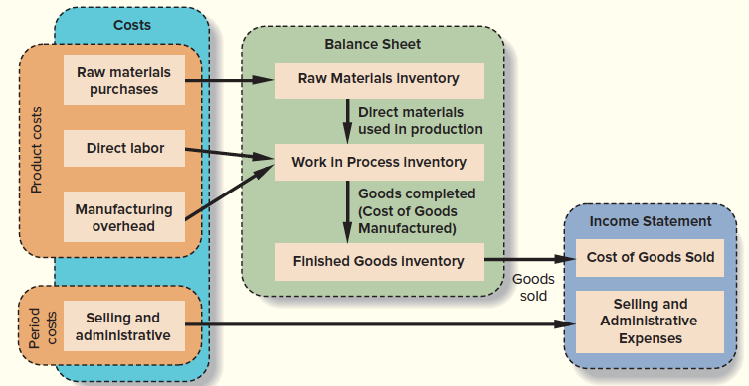
Flow of Costs: A Conceptual Overview
Access the text alternative for slide images.

Slide 8
Job-Order Costing: The Flow of Costs
To illustrate the cost flows within a job-order costing system, we will record Ruger Corporation’s transactions for the month of April. Ruger is a producer of gold and silver commemorative medallions, and it worked on only two jobs in April.
Job A, a special minting of 1,000 gold medallions commemorating the invention of motion pictures, was started during March and completed in April. As of March 31, Job A had been assigned $30,000 in manufacturing costs, which corresponds with Ruger’s Work in Process balance on April 1 of $30,000.
Job B, an order for 10,000 silver medallions commemorating the fall of the Berlin Wall, was started in April and was incomplete at the end of the month.

Slide 9
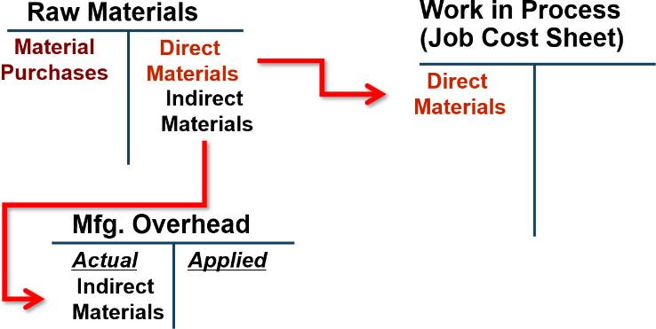
Purchase of Raw Materials – T-Accounts
Purchase of raw materials in T-account form.
Access the text alternative for slide images.

Slide 10
Purchase of Raw Materials – Journal Entry
Purchase of raw materials in journal entry form: On April 1, Ruger Corporation had $7,000 in raw materials on hand. During the month, the company purchased on account an additional $60,000 in raw materials.
(1)
Raw Materials | 60,000
Accounts Payable |  | 60,000

Slide 11
Issue of Direct and Indirect Materials
During April, materials requisition forms were prepared to authorize withdrawing $52,000 in raw materials from the storeroom for use in production. These raw materials included $50,000 of direct and $2,000 of indirect materials. Entry (2) records issuing the materials to the production departments.
(2)
Work in Process | 50,000
Manufacturing Overhead | 2,000
Raw Materials |  | 52,000

Slide 12
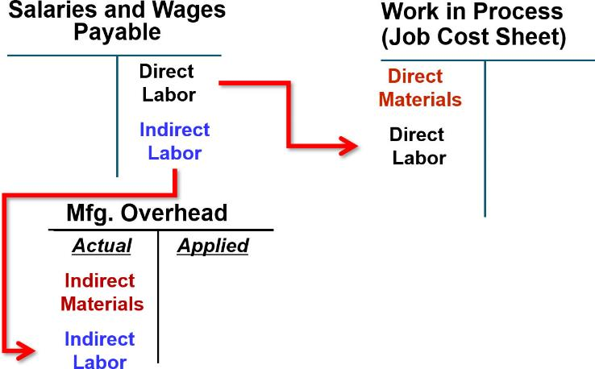
Recording Labor Cost: T-Account
Access the text alternative for slide images.

Slide 13
Recording Labor Cost: Journal Entry
In April, the employee time tickets (which provide hourly summaries of each employee’s activities throughout the day) included $60,000 recorded for direct labor and $15,000 for indirect labor. The following entry summarizes these costs:
(3)
Work in Process | 60,000
Manufacturing Overhead | 15,000
Salaries and Wages Payable |  | 75,000

Slide 14
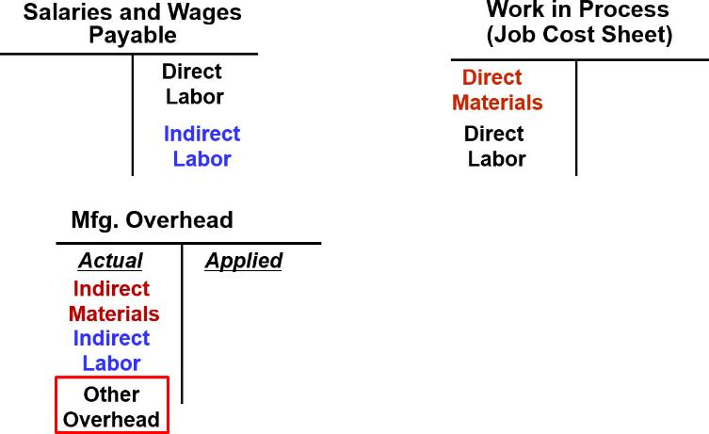
Recording Actual Manufacturing Overhead Costs: T-Account
Access the text alternative for slide images.

Slide 15
Recording Actual Manufacturing Overhead Costs: Journal Entry
Assume that Ruger Corporation incurred the following general factory costs during April:
Utilities (heat, water, and power), $21,000.
Rent on factory equipment, $16,000.
Miscellaneous factory overhead costs, $3,000.
(4)
Manufacturing Overhead | 40,000
Accounts Payable* |  | 40,000
*Accounts such as Cash may also be credited.

Slide 16
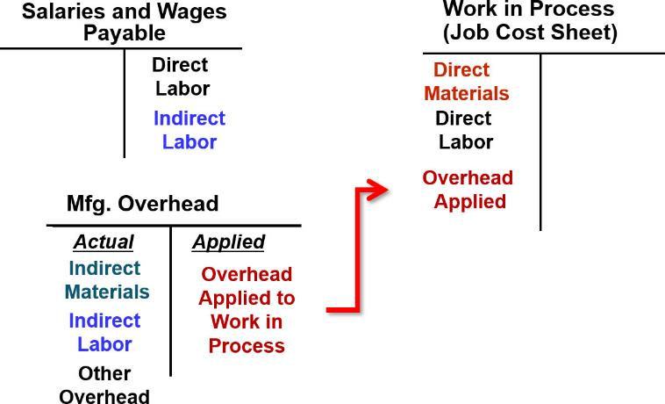
Applying Manufacturing Overhead Costs to Work in Process: T-Account
If actual and applied manufacturing overhead are not equal, a year-end adjustment is required.
Access the text alternative for slide images.

Slide 17
Applying Manufacturing Overhead Costs to Work in Process: Journal Entry
Assume that Ruger Corporation’s predetermined overhead rate is $6 per machine-hour. Also assume that during April, 10,000 machine-hours were worked on Job A and 5,000 machine-hours were worked on Job B (a total of 15,000 machine-hours). Thus, $90,000 in overhead cost ($6 per machine-hour×15,000 machine-hours = $90,000) would be applied to Work in Process. The following entry records the application of manufacturing overhead to Work in Process:
(5)
Work in Process | 90,000
Manufacturing Overhead |  | 90,000

Slide 18
Accounting for Nonmanufacturing Costs
Nonmanufacturing costs are not assigned to individual jobs; rather they are expensed in the period incurred.
Examples:
Salary expense of employees who work in a marketing, selling, or administrative capacity are expensed in the period incurred.
Advertising expenses are expensed in the period incurred.

Slide 19
Nonmanufacturing Costs 1
Ruger Corporation incurred $30,000 in selling and administrative salary costs during April. The following entry summarizes the accrual of those salaries:
(6)
Salaries Expense | 30,000
Salaries and Wages Payable |  | 30,000
Depreciation on office equipment during April was $7,000. The entry is as follows:
(7)
Depreciation Expense | 7,000
Accumulated Depreciation |  | 7,000

Slide 20
Nonmanufacturing Costs 2
Advertising was $42,000, and other selling and administrative expenses in April totaled $8,000. The following entry records these items:
(8)
Advertising Expense | 42,000
Other Selling and Administrative Expense | 8,000
Accounts Payable* |  | 50,000
*Other accounts such as Cash may also be credited.

Slide 21
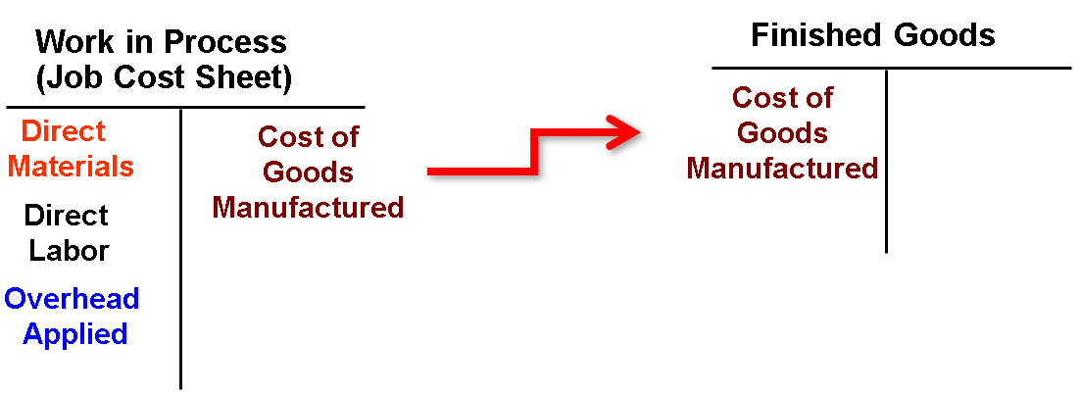
Transferring Completed Jobs from Work in Process to Finished Goods: T-Account
Access the text alternative for slide images.

Slide 22
Transferring Completed Jobs from Work in Process to Finished Goods: Journal Entry
Job A was completed during April, and Job B was incomplete at the end of the month. Thus, the following entry transfers the cost of Job A from Work in Process to Finished Goods:
(9)
Finished Goods | 158,000
Work in Process |  | 158,000
Because Job B was not completed by the end of the month, its assigned costs will remain in Work in Process and carry over to the next month. If a balance sheet were prepared at the end of April, the cost accumulated thus far on Job B ($72,000) would appear in the asset account Work in Process.

Slide 23
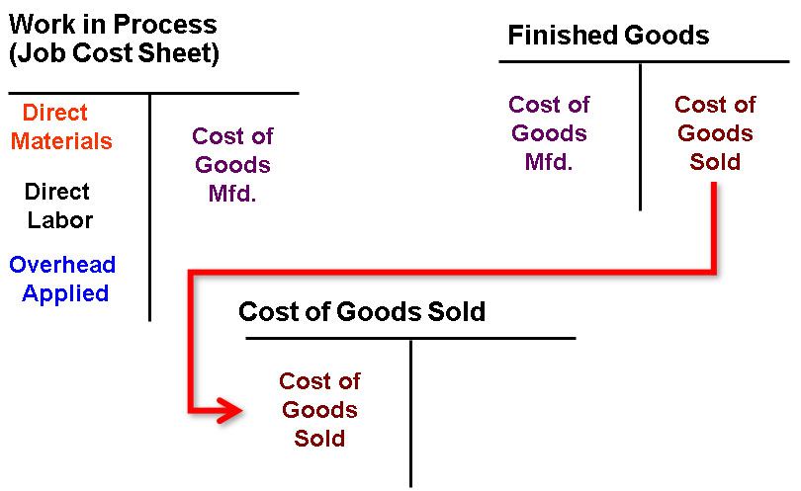
Transferring Finished Goods to Cost of Goods Sold: T-Account
Access the text alternative for slide images.

Slide 24
Transferring Finished Goods to Cost of Goods Sold: Journal Entry
For Ruger Corporation, we will assume 750 of the 1,000 gold medallions in Job A were shipped to customers by the end of the month for total sales revenue of $225,000. Because 1,000 units were produced and the total cost of the job from the job cost sheet was $158,000, the unit product cost was $158. The following journal entries would record the sale (all sales were on account):
(10)
Accounts Receivable | 225,000
Sales |  | 225,000
(11)
Cost of Goods Sold | 118,500
Finished Goods |  | 118,500

Slide 25
Learning Objective 3
Prepare schedules of cost of goods manufactured and cost of goods sold and an income statement.

Slide 26
Schedules of Cost of Goods Manufactured and Cost of Goods Sold
The schedules contain three types of costs:
Direct materials.
Direct labor.
Manufacturing overhead.
The schedules calculate:
The cost of raw material and direct labor used in production and the amount of manufacturing overhead applied to production.
The manufacturing costs associated with goods that were finished during the period.

Slide 27
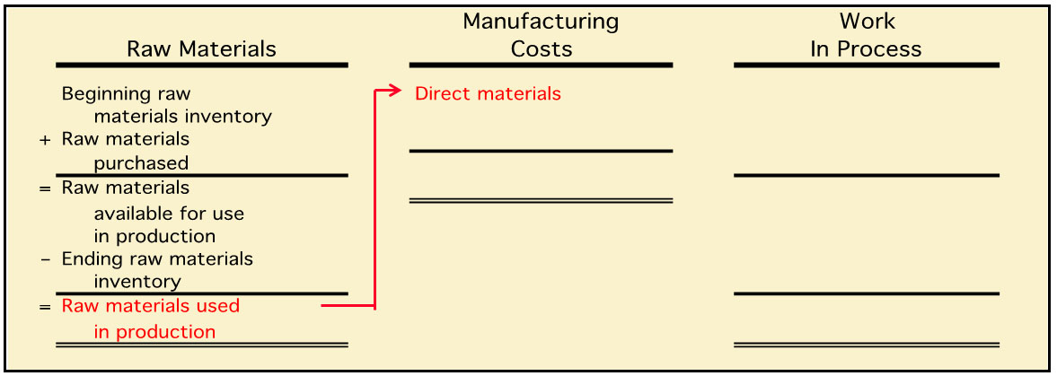
Product Cost Flows 1
Raw material purchases made during the period are added to beginning raw materials inventory. The ending raw materials inventory is deducted to arrive at the raw materials used in production.
As items are removed from raw materials inventory and placed into the production process, they are called direct materials.
Access the text alternative for slide images.

Slide 28
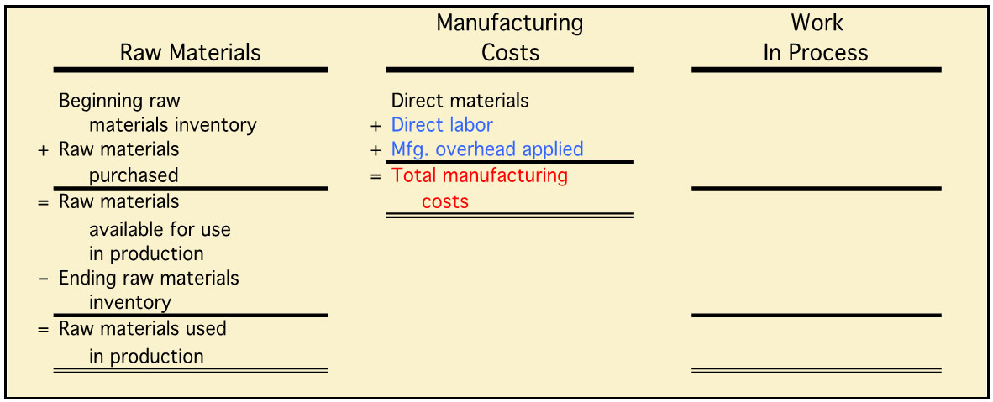
Product Cost Flows 2
Direct labor used in production and manufacturing overhead applied to production are added to direct materials to arrive at total manufacturing costs.
Access the text alternative for slide images.

Slide 29
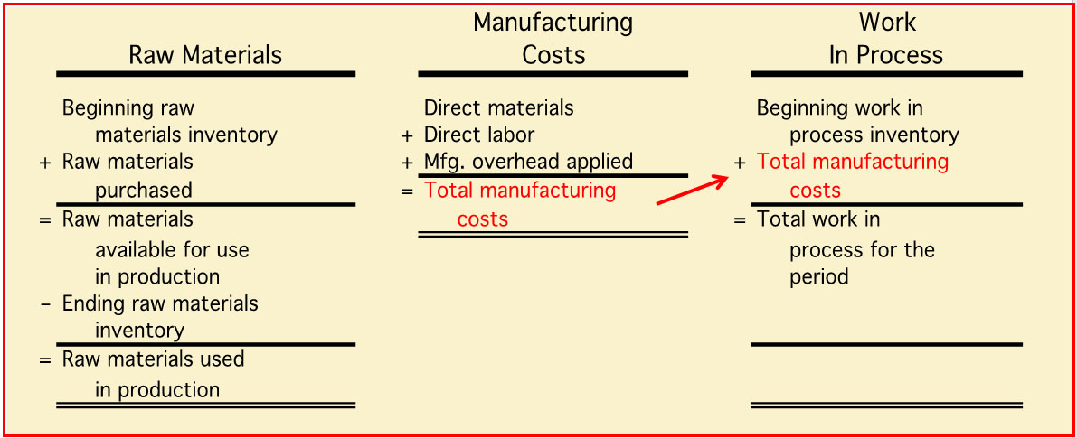
Product Cost Flows 3
Total manufacturing costs are added to the beginning work in process to arrive at total work in process.
Access the text alternative for slide images.

Slide 30
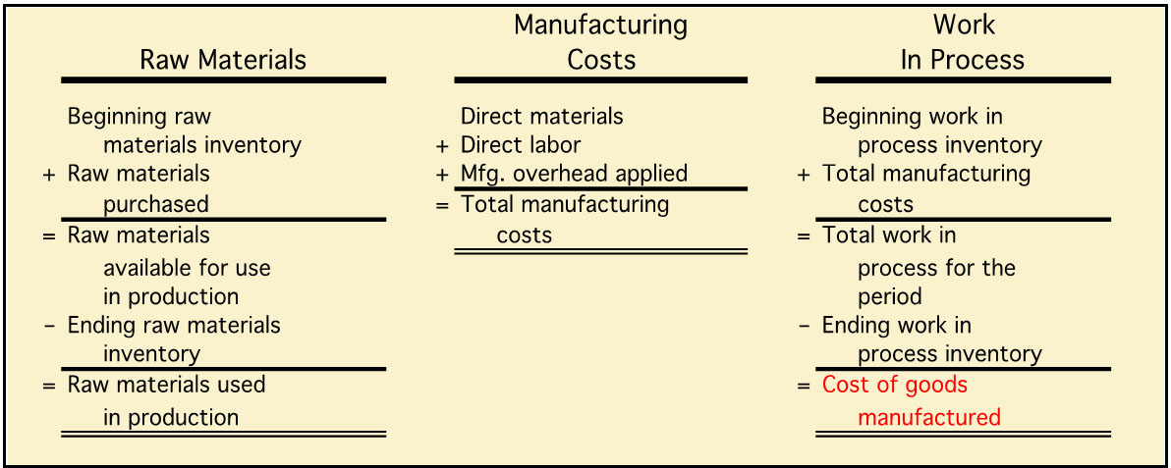
Product Cost Flows 4
The ending work in process inventory is deducted from the total work in process for the period to arrive at the cost of goods manufactured.
Access the text alternative for slide images.

Slide 31
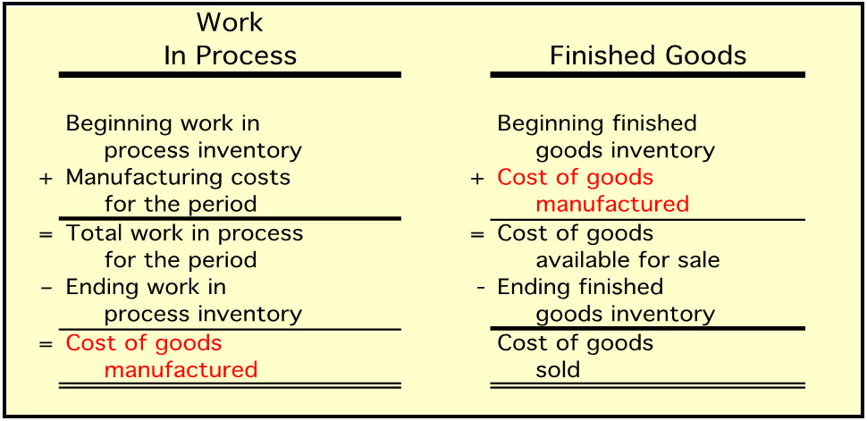
Product Cost Flows 5
The cost of goods manufactured is added to the beginning finished goods inventory to arrive at cost of goods available for sale. The ending finished goods inventory is deducted from this figure to arrive at cost of goods sold.
Access the text alternative for slide images.

Slide 32
Quick Check 1
Beginning raw materials inventory was $32,000. During the month, $276,000 of raw material was purchased. A count at the end of the month revealed that $28,000 of raw material was still present. What is the cost of direct material used?
a. $276,000.
b. $272,000.
c. $280,000.
d. $2,000.

Slide 33
Quick Check 1a
Beginning raw materials inventory was $32,000. During the month, $276,000 of raw material was purchased. A count at the end of the month revealed that $28,000 of raw material was still present. What is the cost of direct material used?
a. $276,000.
b. $272,000.
c. Answer: $280,000.
d. $2,000.
Beg. raw materials | $ 32,000
+ Raw materials purchased | 276,000
= Raw materials available for use in production | $308,000
− Ending raw materials inventory | 28,000
= Raw materials used in production | $280,000

Slide 34
Quick Check 2
Direct materials used in production totaled $280,000. Direct labor was $375,000, and $180,000 of manufacturing overhead was added to production for the month. What were total manufacturing costs incurred for the month?
a. $555,000.
b. $835,000.
c. $655,000.
d. Cannot be determined.

Slide 35
Quick Check 2a
Direct materials used in production totaled $280,000. Direct labor was $375,000, and $180,000 of manufacturing overhead was added to production for the month. What were total manufacturing costs incurred for the month?
a. $555,000.
b. Answer: $835,000.
c. $655,000.
d. Cannot be determined.
Direct materials | $280,000
+ Direct labor | 375,000
+ Mfg. overhead applied | 180,000
= Mfg. costs incurred for the month | $835,000

Slide 36
Quick Check 3
Beginning work in process was $125,000. Manufacturing costs added to production for the month were $835,000. There were $200,000 of partially finished goods remaining in work in process inventory at the end of the month. What was the cost of goods manufactured during the month?
a. $1,160,000.
b. $910,000.
c. $760,000.
d. Cannot be determined.

Slide 37
Quick Check 3a
Beginning work in process was $125,000. Manufacturing costs added to production for the month were $835,000. There were $200,000 of partially finished goods remaining in work in process inventory at the end of the month. What was the cost of goods manufactured during the month?
a. $1,160,000.
b. $910,000.
c. Answer: $760,000.
d. Cannot be determined.
Beginning work in process inventory | $125,000
+ Mfg. costs incurred for the period | 835,000
= Total work in process during the period | $960,000
− Ending work in process inventory | 200,000
= Cost of goods manufactured | $760,000

Slide 38
Quick Check 4
Beginning finished goods inventory was $130,000. The cost of goods manufactured for the month was $760,000, and the ending finished goods inventory was $150,000. What was the cost of goods sold for the month?
a. $20,000.
b. $740,000.
c. $780,000.
d. $760,000.

Slide 39
Quick Check 4a
Beginning finished goods inventory was $130,000. The cost of goods manufactured for the month was $760,000, and the ending finished goods inventory was $150,000. What was the cost of goods sold for the month?
a. $20,000.
b. Answer: $740,000.
c. $780,000.
d. $760,000.
$130,000 + $760,000 = $890,000
$890,000 − $150,000 = $740,000

Slide 40
Learning Objective 4
Compute underapplied or overapplied overhead cost and prepare the journal entry to close the balance in Manufacturing Overhead to the appropriate accounts.

Slide 41
Key Concepts
The difference between the overhead cost applied to Work in Process and the actual overhead costs of a period is referred to as either under- or overapplied overhead.
Underapplied overhead exists when the amount of overhead applied to jobs during the period using the predetermined overhead rate is less than the total amount of overhead actually incurred during the period.
Overapplied overhead exists when the amount of overhead applied to jobs during the period using the predetermined overhead rate is greater than the total amount of overhead actually incurred during the period.

Slide 42
Overhead Application 1
PearCo’s actual overhead for the year was $650,000 with a total of 170,000 direct labor-hours worked on jobs.
PearCo’s predetermined overhead rate is $4.00 per direct labor-hour.
Overhead applied during the period: Applied overhead = P O H R×Actual direct labor-hours Applied overhead = $4.00 per D L H×170,000 D L H = $680,000

Slide 43
Overhead Application 2
PearCo’s actual overhead for the year was $650,000 with a total of 170,000 direct labor-hours worked on jobs.
PearCo’s predetermined overhead rate is $4.00 per direct labor-hour.
PearCo has overapplied overhead for the year by $30,000. What will PearCo do?
Overhead applied during the period: Applied overhead = P O H R×Actual direct labor-hours Applied overhead = $4.00 per D L H×170,000 D L H = $680,000

Slide 44
Quick Check 5
Tiger, Inc., had actual manufacturing overhead costs of $1,210,000 and a predetermined overhead rate of $4.00 per machine-hour. Tiger, Inc., worked 290,000 machine-hours during the period. Tiger’s manufacturing overhead is:
a. $50,000 overapplied.
b. $50,000 underapplied.
c. $60,000 overapplied.
d. $60,000 underapplied.

Slide 45
Quick Check 5a
Tiger, Inc., had actual manufacturing overhead costs of $1,210,000 and a predetermined overhead rate of $4.00 per machine-hour. Tiger, Inc., worked 290,000 machine-hours during the period. Tiger’s manufacturing overhead is:
a. $50,000 overapplied.
b. Answer: $50,000 underapplied.
c. $60,000 overapplied.
d. $60,000 underapplied.
Overhead applied
$4.00 per hour × 290,000 hours = $1,160,000
Underapplied overhead
$1,210,000 − $1,160,000 = $50,000

Slide 46
Disposition of Overapplied and Underapplied Overhead 1
Any remaining balance in the Manufacturing Overhead account, such as PearCo’s $30,000 of overapplied overhead, is disposed of in one of two ways:
It can be closed to Cost of Goods Sold.
It can be closed proportionally to Work in Process, Finished Goods, and Cost of Goods Sold.

Slide 47
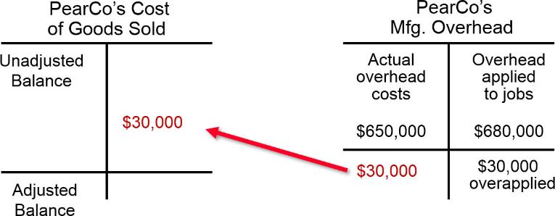
Disposition of Overapplied and Underapplied Overhead 2
The journal entry, in T-account form, to close out PearCo’s $30,000 of overapplied overhead into Cost of Goods Sold:
Access the text alternative for slide images.

Slide 48
Disposition of Overapplied and Underapplied Overhead 3
Calculating the allocation of under- or overapplied overhead between Work in Process, Finished Goods, and Cost of Goods Sold:
Let’s assume the overhead applied in Ending Work in Process Inventory, Ending Finished Goods Inventory, and Cost of Goods Sold is $68,000, $204,000, and $408,000, respectively (total value of accounts $680,000).

Slide 49
Disposition of Overapplied and Underapplied Overhead 4
In this case, the allocation percentages for Work in Process, Finished Goods, and Cost of Goods would be:
Ending WIP inventory = | $68,000 ÷ $680,000 = 10%
Ending finished goods inventory = | $204,000 ÷ $680,000 = 30%
Cost of goods sold = | $408,000 ÷ $680,000 = 60%

Slide 50
Disposition of Overapplied and Underapplied Overhead 5
The allocation of the $30,000 of overapplied overhead would be:
 | Amount | Percent of Total | Allocation of $30,000
Work in process | $ 68,000 | 10% | $ 3,000
Finished goods | 204,000 | 30% | 9,000
Cost of goods sold | 408,000 | 60% | 18,000
Total | $680,000 | 100% | $30,000

Slide 51
Disposition of Overapplied and Underapplied Overhead 6
 | Amount | Percent of Total | Allocation of $30,000
Work in process | $ 68,000 | 10% | $ 3,000
Finished goods | 204,000 | 30% | 9,000
Cost of goods sold | 408,000 | 60% | 18,000
Total | $680,000 | 100% | $30,000
Manufacturing Overhead | 30,000
Work in Process Inventory |  | 3,000
Finished goods Inventory |  | 9,000
Cost of Goods Sold |  | 18,000

Slide 52
Disposition of Overapplied and Underapplied Overhead 7
In summary, there are two methods for disposing of under- and overapplied overhead:
Close out to Cost of Goods Sold.
Allocate between Work in Process, Finished Goods, and Cost of Goods Sold.
The latter method is considered more accurate, but it is more complex to compute.

Slide 53
Quick Check 6
What effect will the overapplied overhead have on net operating income?
a. Net operating income will increase.
b. Net operating income will be unaffected.
c. Net operating income will decrease.

Slide 54
Quick Check 6a
What effect will the overapplied overhead have on net operating income?
a. Answer: Net operating income will increase.
b. Net operating income will be unaffected.
c. Net operating income will decrease.

Slide 55
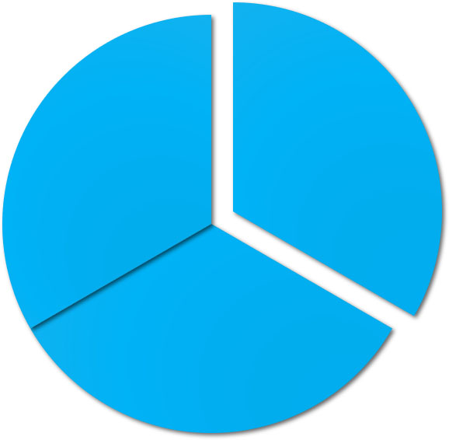
End of Chapter 3
© 2021 McGraw Hill. All rights reserved. Authorized only for instructor use in the classroom. No reproduction or further distribution permitted without the prior written consent of McGraw Hill.

Slide 56
Accessibility Content: Text Alternatives for Images

Slide 57
Flow of Costs: A Conceptual Overview – Text Alternative
Return to parent-slide containing images.
The three panels in the diagram represent costs, balance sheet, and income statement. The panel on the left, Costs, contains three elements of Product costs: Raw materials purchases, Direct labor, and Manufacturing overhead. Costs also include Period costs, which are selling and administrative. Arrows from the Costs panel to the Balance Sheet panel show the flow of various costs:
Raw materials purchases in Costs become Raw Materials Inventory on the Balance Sheet. These are the direct materials used in production.
Direct labor and Manufacturing overhead in Costs become Work in Process Inventory on the Balance Sheet. Goods completed (Cost of Goods Manufactured) then become Finished Goods Inventory on the Balance Sheet.
Selling and administrative period costs become Selling and Administrative Expenses on the Income Statement (the third panel).
Finished Goods Inventory from the Balance Sheet becomes, when goods are sold, Cost of Goods Sold on the Income Statement.
Return to parent-slide containing images.

Slide 58
Purchase of Raw Materials – T-Accounts – Text Alternative
Return to parent-slide containing images.
The first T-account is for Raw Materials and has Material Purchases in the left column and Direct Materials and Indirect Materials in the right column. The direct materials are listed again in the left column of a second T-account for Work in Process (Job Cost Sheet). The actual indirect materials are listed again in the left column of a T-account labeled Manufacturing Overhead.
Return to parent-slide containing images.

Slide 59
Recording Labor Cost: T-Account – Text Alternative
Return to parent-slide containing images.
The first T-account is for Salaries and Wages Payable and contains Direct Labor and Indirect Labor in the right column. The second T-account is for Work in Process (Job Cost Sheet) and has Direct Materials and Direct Labor in the left column. The third T-account is for Manufacturing Overhead and has actual Indirect Materials and Indirect Labor in the left column.
Return to parent-slide containing images.

Slide 60
Recording Actual Manufacturing Overhead Costs: T-Account – Text Alternative
Return to parent-slide containing images.
The first T-account is for Salaries and Wages Payable and contains Direct Labor and Indirect Labor in the right column. The second T-account is called Work in Process (Job Cost Sheet) and has Direct Materials and Direct Labor in the left column. The third T-account is called Manufacturing Overhead and has actual Indirect Materials, Indirect Labor, and Other Overhead in the left column.
Return to parent-slide containing images.

Slide 61
Transferring Completed Jobs from Work in Process to Finished Goods: T-Account – Text Alternative
Return to parent-slide containing images.
The Work in Process T-account has Direct Materials, Direct Labor, and Overhead Applied in the left column and Cost of Goods Manufactured in the right column. A second T-account for Finished Goods has Cost of Goods Manufactured in the left column.
Return to parent-slide containing images.

Slide 62
Transferring Finished Goods to Cost of Goods Sold: T-Account – Text Alternative
Return to parent-slide containing images.
The T-account for Work in Process has Direct Materials, Direct Labor, and Overhead Applied in the left column and Cost of Goods Manufactured in the right column. A second T-account called Finished Goods has Cost of Goods Manufactured in the left column and Cost of Goods Sold in the right column. A third T-account called Cost of Goods Sold has Cost of Goods Sold in the left column.
Return to parent-slide containing images.

Slide 63
Product Cost Flows 1 – Text Alternative
Return to parent-slide containing images.
The summary has columns for Raw Materials, Manufacturing Costs, and Work in Process. The items in the Raw Materials column form an equation: Beginning raw materials inventory plus Raw materials purchased equals Raw materials available for use in production minus Ending raw materials inventory equals Raw materials used in production. As raw materials are placed into production, they become direct materials so Direct materials is entered in the Manufacturing Costs column.
Return to parent-slide containing images.

Slide 64
Product Cost Flows 2 – Text Alternative
Return to parent-slide containing images.
The summary has columns for Raw Materials, Manufacturing Costs, and Work in Process. The Raw Materials column is repeated from the previous slide. The items in the Manufacturing Costs column form an equation: Direct materials plus Direct labor plus Manufacturing overhead applied equals Total manufacturing costs.
Return to parent-slide containing images.

Slide 65
Product Cost Flows 3 – Text Alternative
Return to parent-slide containing images.
The summary has columns for Raw Materials, Manufacturing Costs, and Work in Process. The Raw Materials and Manufacturing Costs columns are repeated from the previous slide. The items in the Work in Process column form an equation: Beginning work in process inventory plus Total manufacturing costs equals Total work in process for the period. The Total manufacturing costs entry in the Manufacturing Costs and Work in Process columns are connected with an arrow indicating that total manufacturing costs are added to the beginning work in process to arrive at total work in process.
Return to parent-slide containing images.

Slide 66
Product Cost Flows 4 – Text Alternative
Return to parent-slide containing images.
The Raw Materials and Manufacturing Costs columns are repeated from the previous slide. The items in the Work in Process column form an equation: Beginning work in process inventory plus Total manufacturing costs equals Total work in process for the period minus Ending work in process inventory equals Cost of goods manufactured.
Return to parent-slide containing images.

Slide 67
Product Cost Flows 5 – Text Alternative
Return to parent-slide containing images.
The Work in Process column is repeated from the previous slide. The second column is for Finished Goods. The items in this column form an equation: Beginning finished goods inventory plus Cost of goods manufactured equals Cost of goods available for sale minus Ending finished goods inventory equals Cost of goods sold.
Return to parent-slide containing images.

Slide 68
Disposition of Overapplied and Underapplied Overhead 2 – Text Alternative
Return to parent-slide containing images.
The first T-account for PearCo’s Cost of Goods Sold shows Unadjusted Balance and Adjusted Balance labels in the left column, and the right column contains the value $30,000. The second T-account is for PearCo's Manufacturing Overhead. The left column contains Actual overhead costs of $650,000, and the right column contains Overhead applied to jobs of $680,000. The result is shown as $30,000 overapplied in the right column. The additional $30,000 is shown, with an arrow, as a transfer to the first T-account.
Return to parent-slide containing images.

