Slide 1
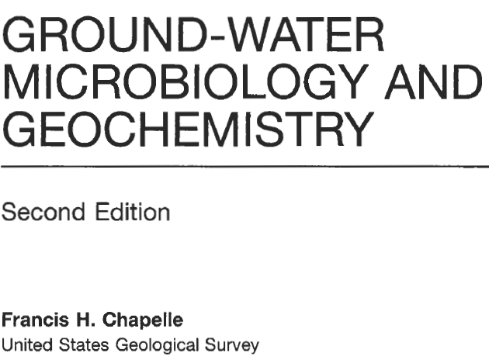

Slide 2
WHO AM I?
Daniel E. Kramer, Professional Geologist (PG/CEG)
Why is this Paper/Chapter Important to ME?
I am a Septic Designer
I am perform and Monitor GW for Clients
I work on Toxic Environment cleanup
I am a human…bacteria/viruses/etc…

Slide 3
Micro Organisms in the Environment? I don’t see any
First this paper discusses organisms – micro.
Surface Sediments (Freshwater)
Surface Sediments (Saltwater)
Subsurface Sediments (Aerobic and Anaerobic)
Water Columns (Shallow or Deep Water Bodies)
Hot Hydrothermal Waters
Frozen Sediments
Extreme Pressure/Temp Regions

Slide 4
Three Primary Lineages
These are also referred to as Domains
Archaea
Bacteria (Prokaryotic) Early Nucleus
Eucarya (Eukaryotic) True Nucleus
Non-Cellular Life Forms
Viruses

Slide 5
TERMS
Deoxyribonucleic acid (DNA) is a molecule that encodes the genetic instructions used in the development and functioning of all known living organisms and many viruses.
Ribonucleic acid (RNA) is a ubiquitous family of large biological molecules that perform multiple vital roles in the coding, decoding, regulation, and expression of genes.
Courtesy of Wikipedia

Slide 6
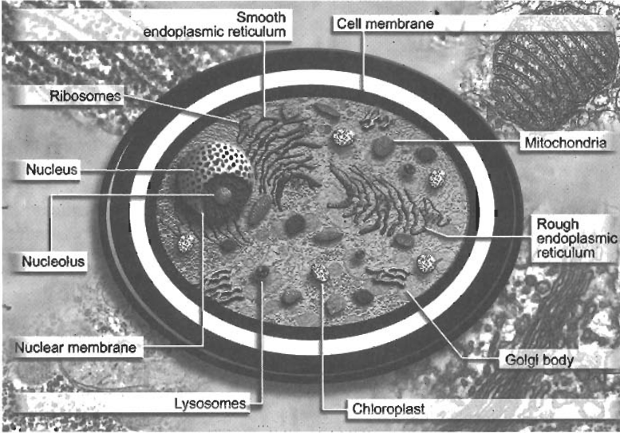
Bacteria Versus Eucarya
Distinct and Simple Cellular Structure vs. Extremely Complex

Slide 7
MORE DETAILS

Slide 8
Archaea
First these were grouped with the Bacteria based on External Structure – Similar
After closer examination
rRNA differences showed that methane producing bacteria (methanogens) were actually distinct and different
Archaea meaning Ancient (older bacteria)…misleading though because not actually bacteria!!!

Slide 9
Tree of LIFE…

Slide 10
Bacteria – Most Important underground
Why? Because they are the most capable of being subsurface, water borne, pressure cooked, and anaerobic (in general).
Eucarya have some importance though…we will go here first

Slide 11
Eucarya - Groundwater
Eucarya = Algae, Fungi, and Protozoa
All have distinct nucleus
Still with “Cell Wall” to protect against osmotic shock
Have many parts dedicated to what are performed by proteins (and other) in bacteria or prokaryotic microorganisms.
Specifically to deal with metabolic functions

Slide 12
Eucarya - More Details
Algae – Photosynthetic
Fungi – heterotrophic or obtain energy from other sources (preexisting Carbon)
Protozoa (Extremely Complex) – Foraminifera, radiolarian, dinoflagellates
Floating Community (zooplankton) or Predatory

Slide 13
Eucarya – In Water
Generally
Lower in water column fewer in number
Lower in GW less fewer in number
Lower in sediment fewer in number.
Higher population in areas of contamination at depth (versus no contamination)
Especially in areas of aerobic digestion or acceleration
Maybe depend on type of contamination

Slide 14
BAD BUGS - Eucarya
Giardia (Giardia lamblia)
Cryptosporidium (Cryptosporidium parvum)
Affect the digestive tract
Inhabit surface water
Enter subsurface through wells and hydraulic injections
>10 meters from recharge point not likely to cause issue.!? Maybe

Slide 15
Brings me to Separate ISSUE
Septic Systems and Central Sewage Systems
Overflow and Through Flow into Creeks
Clogging of Soils (Sewage Reduction Factor)
Oxygenate the Bugs to Process them, go anaerobic to denitrify (watch out for E.Coli)
WHY IS THIS REALLY IMPORTANT?

Slide 16
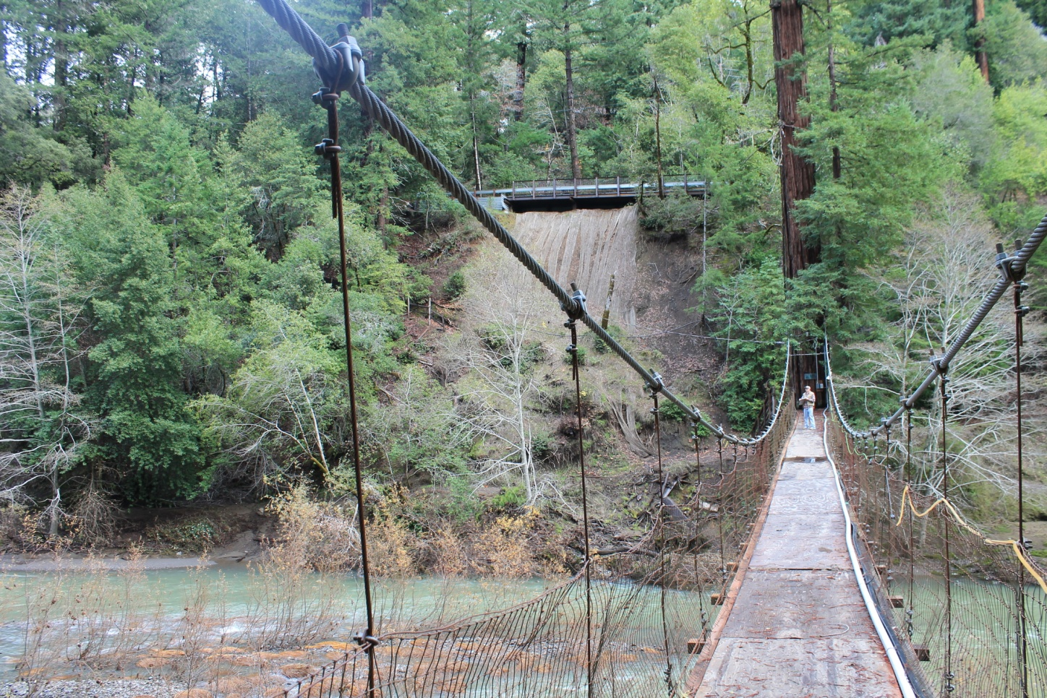
Septic Shock!
May be the largest contribution to ground water type systems of bacteria and eucarya.

Slide 17
Back to Back-teria
Bacteria – Classified on DNA, cell types, cell growth, bio-chem transformations they produce.
Named (Binomial Nomenclature) as in E.Coli short for Escherichia Coli
Taxonomy is significant and important – distinguish between bacterial types and to identify similarities between close related species.

Slide 18
Gram Stain
May have heard of it? Used to stain Bacteria…maybe others to
Determines Cell Wall Type
Pure Culture – Smear on Glass – Heat – Put with Solution – Wash with Solution …
If Gram Positive still have Color – Peptidoglycan
If Gram Negative color is gone - lipopolysaccharides and proteins instead

Slide 19
Gram Stain

Slide 20
Shapes

Slide 21
More Shapes

Slide 22
And More Shapes!
#^*@+ Virus…
I HATE VIRUS
Its OK…He is With Me.

Slide 23
Viruses
Infectious Hepatitis
May or May not spread in Ground Water? Lets play this one on the safe side…
However they can persist in GW environs
Weeks to Months (i.e. Polio, rotavirus, usual suspects)
THEY are not even ALIVE – Really Scary Beasts

Slide 24
Viruses Continued
What is a Virus?
Not Cells – cannot reproduce independently
No independent metabolism
Are they living? – Inanimate Crystals of Tobacco Virus caused disease to occur…
Basically they live to find bacteria to get into…but what is interesting is that they tend to control the population and keep the whole thing in check….

Slide 25
Big Picture – What?
What might the number of bacteria, eukaryotes, Archaea, or virus counts in a water sample tell us about potential contamination concentrations in a groundwater sample?
Given the evolutionary sequence of the aforementioned organism series, what might one infer about early primordial groundwater chemistry within hyporheic zones?

